Slide 1

SQL for Data Science Capstone Project
By
Cornelius Enetomhe
23/10/20245

Slide 2
The Project
The dataset
The data used for this analysis is Olympics Dataset - 120 years of data. The dataset, originally, is made up of two files . athlete_events.csv and noc_regions.csv . This dataset was chosen because it gives the records of Olympics medal awards for different categories of sport, the countries that participated in the games, names, age, medals etc. The dataset is useful for news agencies reporting about the different feats in the 120 years of Olympics games existence. The dataset can also be a wealth of information for countries aspiring to improve on their performance in the subsequent Olympics events
The Client
SportStats, a sports analysis firm, looking to gain insights through trends ranging from the athletes to events from the Olympics dataset. The findings from the data will be shared to SportsStats partners, local news and elite personal trainers, for news stories and health insights. Not only will SportsStats and their partners will gain perspective but also those who are highly interested in sports or fitness.

Slide 3

PROJECT PROPOSAL
This project consists of showing data and statistics on the dominant countries in the Olympic Games, showing their development in the most popular sports, as well as showing which are the most popular events and competitions.
The result of this analysis seeks to help the company communicate key news to its partners by providing valuable information on sports trends.

Slide 4
PROPOSED ERD
ID
Name
Sex
Age
Height
eight
Team
N
Games
Year
Season
City
Sport
Event
athlete_event
Athle_ID
Athle_Name
Sex
Age
Height
Weight
Team
Noc
Games
Year
Season
City
Sport
Event
noc_regions
Noc
Region
Notes

Slide 5

My major focus was on these questions:
Which countries have won the most gold medals in the Olympic Games?
What is the most practiced sport?
How many male and female events do we have?
What is the relationship between age and sport?
Does weight and height contribute to the award of a medal?
Which country had the best ratio of participants to medals won?

Slide 6
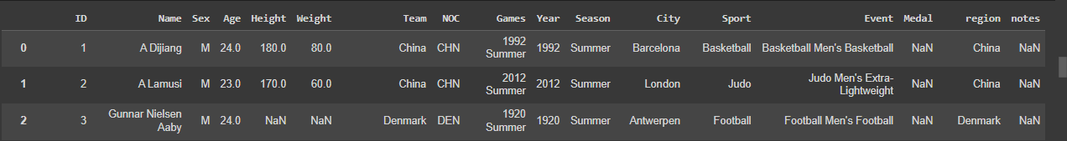
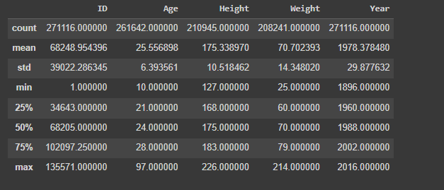
Merge dataset
Importing the Datasets
To import data I made use of google.colab to gain access to the files on my google drive and mount it on my notebook and
read it with pandas.
I combined together the athlete_events.csv and the noc_regions.csv files together. The merged table
had 271116 rows and 17 columns
Basics summary of the dataset tells us the average ages,
heights and weights of all participants in all events over the
120 years of the Olympic games.

Slide 7
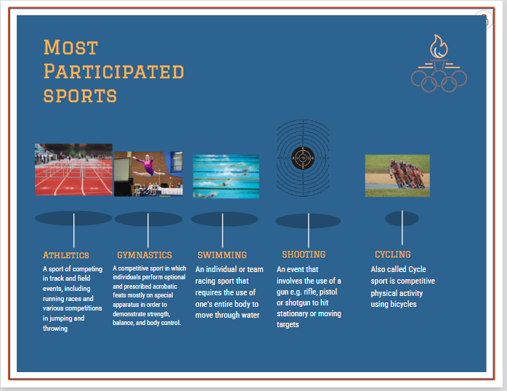
Sporting events with the most number of participants over the Last 120 years of the Olympics.

Slide 8

Initial Hypothesis
We would see that the countries that have more gold medals are those with that would have the most investment (USA, China).
Factors such as height and weight are important but it also depends on the event they are participating in
The most participated sport would be track and field(athletics)
These questions help guide my analysis and lead me to deeper analysis.

Slide 9
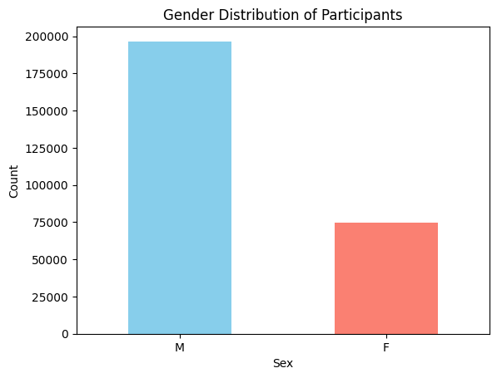
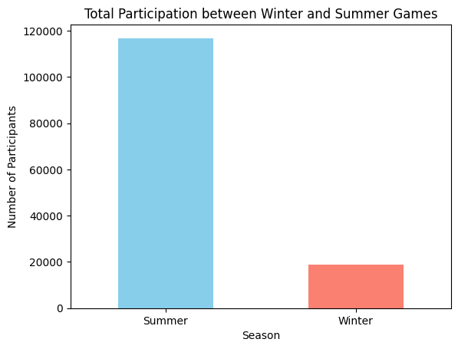
Statistics Summary
We see a distinction between male and female participants over the years, mostly due to more male events.
We also see the very small volume of winter
events compared to that of the summer over the past few years

Slide 10
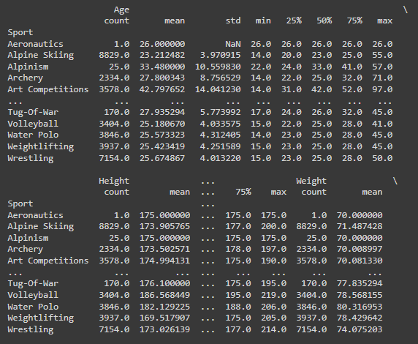
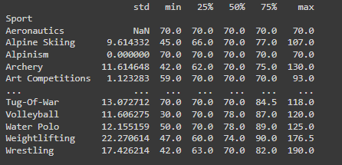
Age, Height and Weight distribution per sport
A view of the statistics summary of the distribution of
Age, Height and Weight in relation to the various
sporting events at the Olympics.

Slide 11
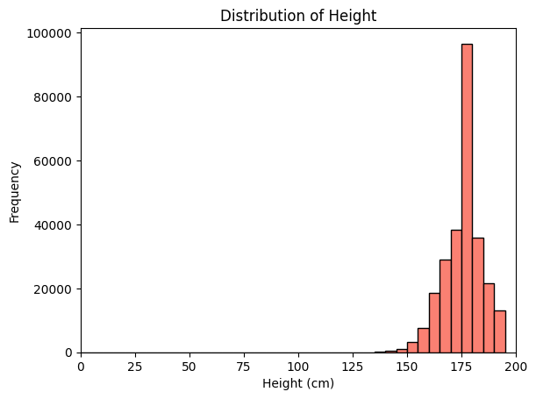
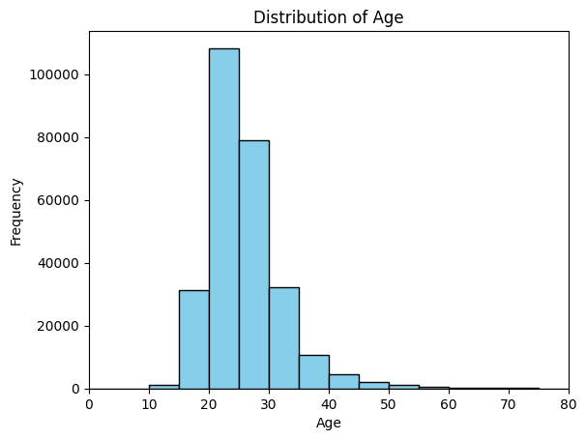
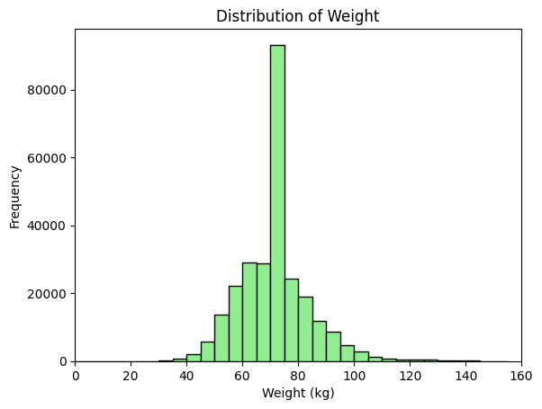
Deeper Analysis (Visualization of distributions)

Slide 12
Deeper Analysis (Medals)
My initial hypotheses suggest USA and China as the top 2 based on investment. I was right about USA but
China didn’t make the top 5 for most gold but for total medals.
USA
RUSSIA
GERMANY
UK
ITALY
2638
1599
1301
678
575

Slide 13
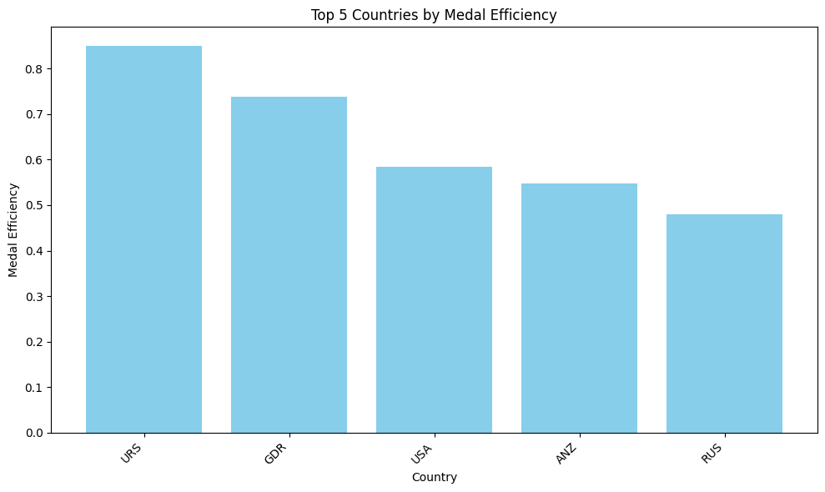
Deeper Analysis (Medals cont.)
We see top 5 countries at the Olympics with the highest ratio of medals won to the number of participants representing them in all sporting events.

Slide 14
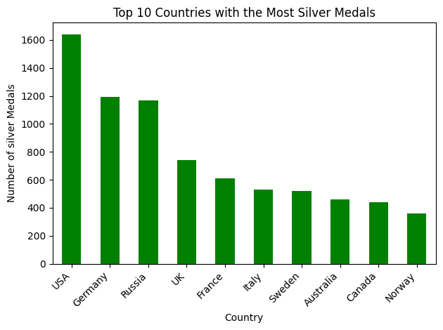
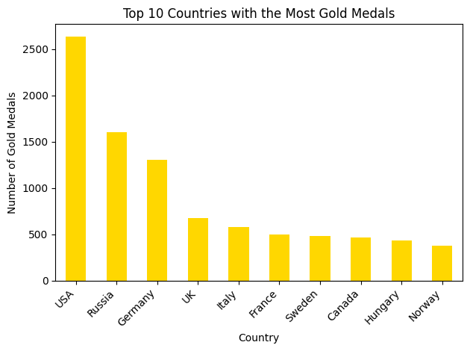
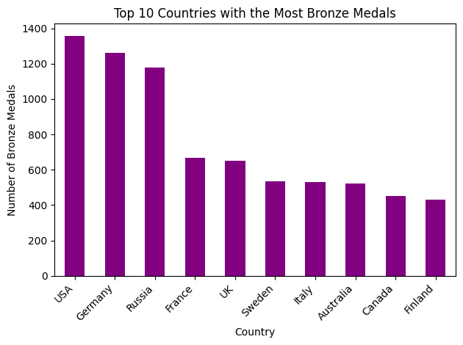
We see countries like USA, Russia, Germany, UK , Sweden, Italy and France are in all categories for medals
Deeper Analysis (TOP 10 Countries for Medals Categories )

Slide 15
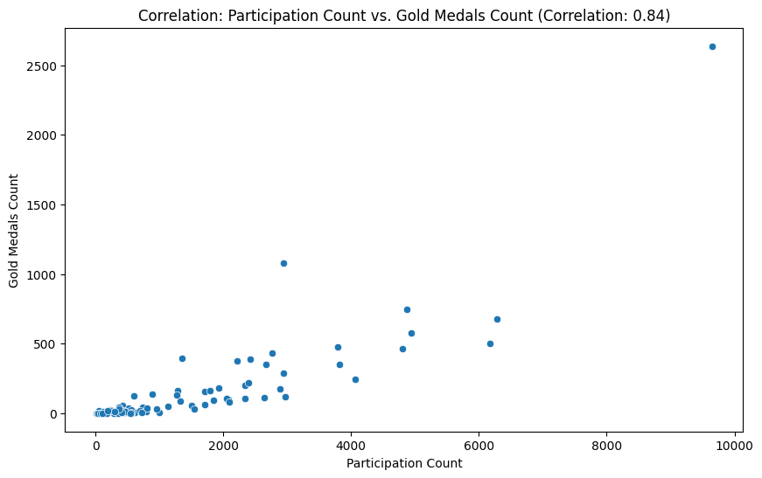
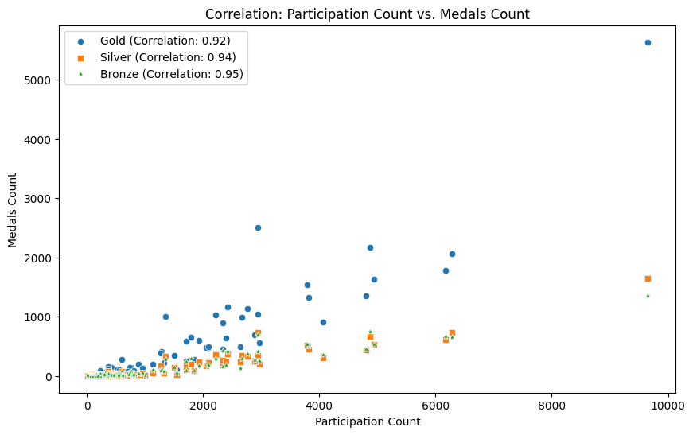
Deeper Analysis(cont.)
In the participation by country and medals
won Analysis, we can see that the correlation between Participation Count and Total Medals Won is 0.92.From this we can infer a positive linear relationship, because as participation increases due to more events or other factors so does the number of medals to be won.

Slide 16
Final Findings(Results of Hypotheses)
The following conclusions can be inferred from the Olympics data
We would see that the countries that have more gold medals are those with that would have the most investment (USA, China).
  USA is the top performing country with both most medals and most gold medals and also ranks 3rd for medal efficiency
  China didn’t feature amongst top 10 countries for most gold medals
  Medals have linear relationships with participation and performance more than anything
  I also wasn't able to prove or disprove if investment had an effect on medals won.
The most participated sport would be track and field(athletics)
  We have seen that amongst the various events done in the olympics, athletics is the sport that has been done the most
Factors such as height and weight are important but it also depends on the event they are participating in
  Each sport event did have different average ranges for age, height and weight.
  Average height and weight also had difference by gender.

Slide 17
Recommendation
Coaches can help guide prospective athletes by using average height and weight in various events to get the in best shape to win medals.
Countries should do more to ensure their athletes pass the qualifying rounds to stand a better chance of winning
Athletes should be encouraged to take part in qualifying rounds for the Olympics as early in their careers as possible
Further analysis can be done on countries that have dominated some events and factors that contributed to that

